Slide 1
Presentation Report
Mysterious Data Analysis
                of
Titanic Smash using SAR
Surendra Kumar Shringi
(170220525013)

Slide 2
Topic to be covered ...
1. History
2. Introduction
3. Environment Setup
4. Problem Statement
5. Methodology
6. Output/Result
7. Future Scope
8. References

Slide 3
1. History
The sinking of the RMS Titanic is one of the most
Infamous shipwrecks in history. On April 15, 1912,
during her maiden voyage, the Titanic sank after
colliding with an iceberg, killing 1502 out of 2224
passengers and crew. This sensational tragedy
shocked the international community and led to
better safety regulations for ships.

Slide 4
2. Introduction
Titanic smash is the biggest lose of the life,So here we are going to analyzing and
predict the Titanic data survivability according to variable importance using analytical
tool with SAR.
The approximate number of passengers at the time of the collision was :
“First class 300, second class 320, third class 750. Total 1440
Officers and crew 940. Total 2340”.

Slide 5
3.Environment Setup
For the Titanic environment setup, we are using below languages,tools and technologies :
1. R Programming language and tools used with list of packages :
a) R programming 3.4.0
b) Rstudio 1.0.153
2. Microsoft Excel tools
3. Machine Learning techniques :
a) Decision Tree
b) Random Forest
4. Packages used :
a) rpart
b) randomforest
c) rattle
d) ggplot2

Slide 6
4. Problem Statement
“The goal of the project was to predict the survivability of passengers based on a set of
Data And predict that they are sinking the Titanic or not”.
For the Titanic sink, we will predict the value of passengers id as 0 or 1 (survival-
Variable) .
We are taking the Data Dictionary which contain variable’s :
Survival
Pclass (passenger class)
Sibsp (siblings spouse)
Parch (parents / chiledren)
Embarked
Ticket
Fare
Cabin

Slide 7
5. Methodology
According to the history of kaggle datasets, we are taking only total 1311 data.
Training set containing 892 samples (train.csv).
Testing sett containing 419 samples (test.csv).
a) Loading the datasets
b) Grouping the dataset according to variable names.
c) Creating a variable in test set “test$Survived” for our prediction that everyone dies.
test$Survived <-0
d) Update the prediction that all female survived
test$Survived[test$sex==’female’] <-1

Slide 8
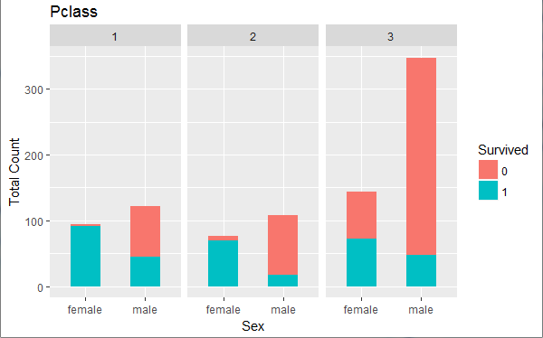
Methodology cont...
Survivability with
Sex and Pclass.

Slide 9
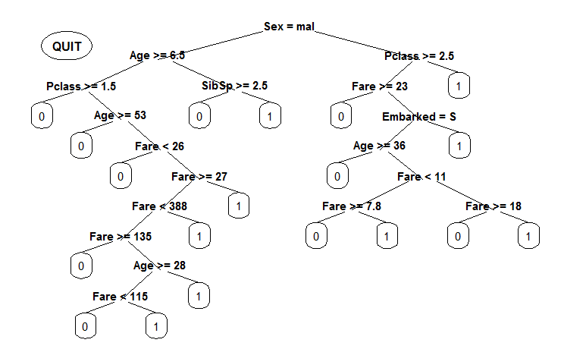
Cont...
Decision tree plot
With importance
Variables.

Slide 10
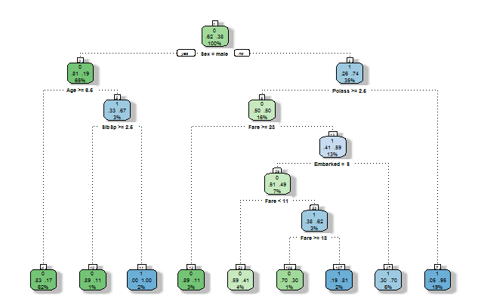
Cont...
Random Forest
Tree with sex and
Age ratio.

Slide 11
6. Output - Result
The final result is comes out to the Titanic Sink in the below list of categories :
The Distribution of numerical features values across the samples.
a) Total samples are 1311 or 40% of the actual number of passengers on board the
Titanic (2224).
b) Survived is a categorical features which contains 0 or 1 values.
c) Around 78% of samples survived representative of the actual survived rate at 80%.
d) Most passengers (> 75%) did not travel with parents or children.
e) Nearly 30% of the passengers had siblings and/or spouses abroad.
f) Fares varied significantly with few passengers (< 1%) paying as high as $512.
g) Few elderly passengers (< 1%) within range of 65-80.

Slide 12
Output – Result cont...
Some features was contain blank , null or empty values :
a) Cabin > Age > Embarked features contain a number null values in that order for the
training data.
b) Cabin > Age are incomplete in case of test dataset.
Data types and various features of the variable’s :
a) Seven features are integer or floats and remaining six in case of test dataset.
b) Five features are strings (objects).
The Distribution of Categorical features :
a) Names are unique across the dataset (count=unique=891)
b) Sex variable as two possible values with 65% male (top=male, freq=418/count891)
c) Cabin values have several duplicates across samples. Alternatively passengers shared
a cabin.
d) Embarked takes three possible values. S port used by most passengers (top=S).
e) Ticket feature has high ratio (22%) of duplicate values (unique=681).

Slide 13
6. Future Scope
By proposing above work, in domain of data analysis we can use such type of
predictions mechanism in natural disasters like earthquake, flooding, building
crash, plane crashes, marine crashes, environmental weather conflicts etc.

Slide 14
10. References
1. Division of the History of Technology, Transportation Collections, National Museum
of American History, in cooperation with the Public Inquiry Mail Service, Smithsonian
Institution,"The Titanic,"http://www.si.edu/resource/faq/nmah/titanic.htm (Washington,
DC: Smithsonian Institution, May 1997).
2. Gannon, Robert, "What Really Sank the Titanic," Popular Science, vol. 246, no. 2
(February 1995), pp. 49-55.
3. Heinreich HW. Industrial Accident Prevention. New York and London, 1941.
Refrigerator, Mister, "R.M.S. Titanic," http://www.scv.net/~fridge/index.htm (May 1998).
4. The datasets collected form www.kaggle.com/titanicsmah.

